Slide 1
Principle of OOP in JS
by Yullia Tsurkan

Slide 2
OOP
ENCAPSULATION
ABSTRACTION
INHERITANCE
POLYMORPHISM

Slide 3
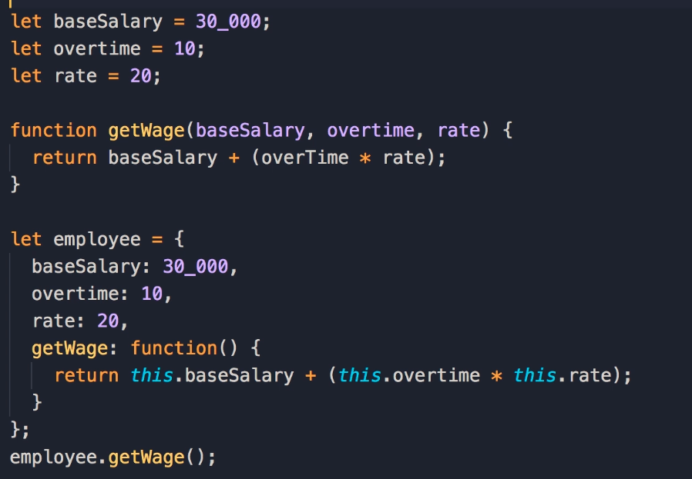
Encapsulation
“The best function are those with no parameters!”
Uncle Bob – Robert C Martin

Slide 4
Encapsulation
Correct encapsulation is important for many reasons:
1. It allows to reuse components. The components can be used in a wider context since they interact with each other only via API and are not sensitive to changes of the inner structure.
2. Encapsulation boosts the development process. The components loosely connected with each other (it means the components, whose code calls other components or uses their code as rarely as possible) can be developed, tested and supplemented independently.
3. Correctly encapsulated components are easier to understand and debug, which makes it easier to maintain an application.
--Hiding of internal data and implementation details of the component from other application components.
--Providing a set of methods to interact with the component (API).

Slide 5
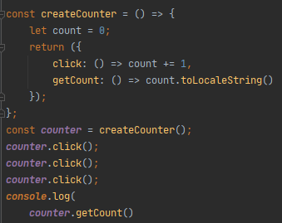
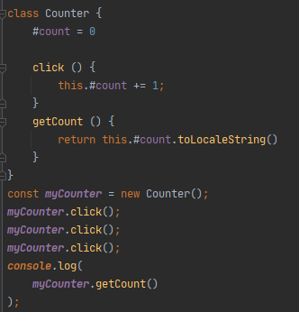

Slide 6
Inheritance
Inheritance allows for parent class to pass functionality to a child class, again, creating clean and reusable code, avoiding repeats.
DON'T REPEAT YOURSELF
JavaScript does not have classes like other languages. It uses the concept of prototypes and prototype chaining for inheritance.
Prototype chaining means an object’s dunder proto or proto property will point to another object instead of pointing to the constructor function prototype. If the other object’s dunder proto or proto property points to another object it will result in the chain. This is called Prototype Chaining.

Slide 7
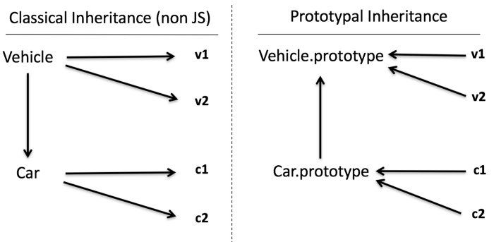

Slide 8
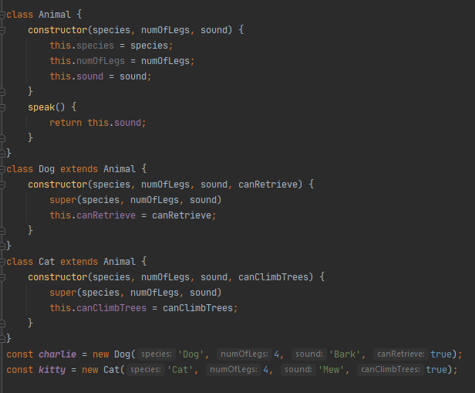

Slide 9
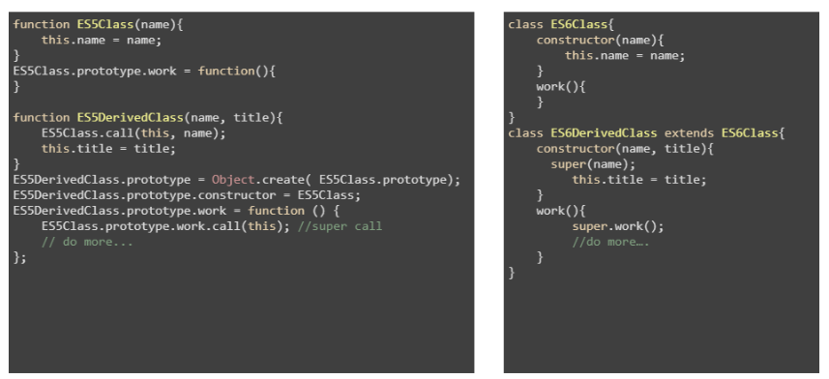

Slide 10
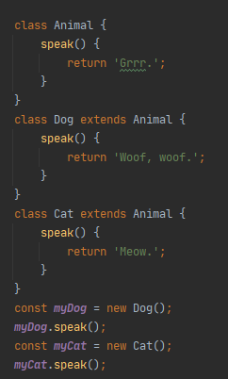
Polymorphism
Polymorphism is the third of principles of object-oriented programming. The word “polymorphism” means having “many forms” or “shapes”.
Polymorphism can occur in two ways:
1) The first way is when a subclass implements its own version of a method that was inherited from its parent class. This type of polymorphism is also called “method overriding”, or “runtime polymorphism”.

Slide 11
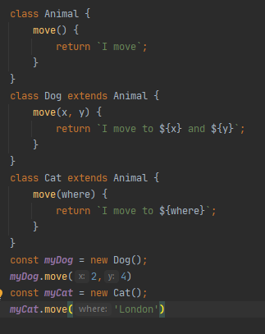
2) The second way in which polymorphism can occur is method overloading.
This is also called “compile-time polymorphism”. This is when two methods have the same name, but different parameters.

Slide 12
Abstraction
The idea behind this principle is that the outside world should be provided with only essential information about an object. It should provide only information relevant for using it. It should not provide information about implementation details of this object.
Only abstract classes can contain abstract methods. Other classes can’t. If class contains abstract method, it should be also abstract. Abstract methods are methods that are declared without any implementation. They are like a placeholder. The implementation is left for child classes that inherit from the abstract class.

Slide 13
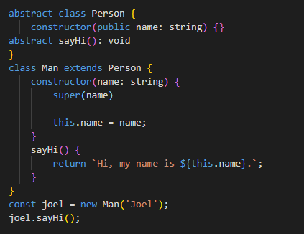
In TypeScript, you can define abstract class using abstract keyword. When you want to declare abstract method you also use the abstract keyword. Now, you can create new normal class and let it inherit from the abstract. In this child class, you can implement the method(s) you declared as abstract in parent abstract class.

Slide 14
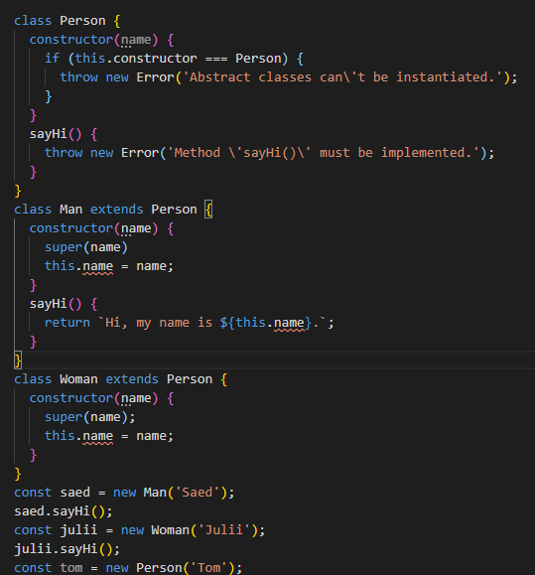
JavaScript doesn’t have a native support for abstract keyword. However, the TypeScript example above can be re-written to plain JavaScript. You can do that by using regular classes with throw statements. These statements will ensure the pseudo-abstract class will not be instantiated and its pseudo-abstract methods implemented.

Slide 15


